Slide 1
APPLIED DATA SCIENCE CAPSTONE
Places to Visit In Delhi
PROJECT BY-
Harsh Ajay Kalra

Slide 2
INDEX
INTRODUCTION ------------------------------------------------------- 03
BUSINESS PROBLEM ----------------------------------------------------------04
DATA ANALYSIS -------------------------------------------------------05
DATA COLLECTION ------------------------------------------------------------ 05 DATA PRE-PROCESSING AND WRANGLING ------------------------------05 DATA FILTERING ---------------------------------------------------------------06
DATA CLEANING -------------------------------------------------------------- 07
MODEL FITTING ------------------------------------------------------ 09
CLUSTERING -------------------------------------------------------------------- 09
COLOR CODING ---------------------------------------------------------------- 10
DATA VISUALIZATION ----------------------------------------------- 11
VISUALIZING TARGET CLUSTER --------------------------------------------- 11 OBSERVATION------------------------------------------------------------------ 12

Slide 3
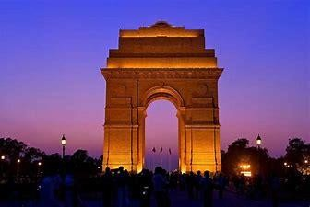
INTRODUCTION
Delhi, the capital of India, has a rich history. The city is dotted with spellbinding mosques, forts, and monuments left over from the Mughal rulers that once occupied the city. The contrast between rambling Old Delhi and well-planned New Delhi is immense, and it's interesting to spend time exploring both. If you feel in need of some relaxation, just head to one of Delhi's flourishing landscaped gardens.
The influence of religious diversity can be seen in the city along with the cultural impact of the Mughal, the ancient Indian and the British. There are many beautiful gardens in the city, away from pollution and busy city life that provide opportunities to walk leisurely during greenery.

Slide 4
The capital city is divided into two sections popularly known as Purani Dilli or Old Delhi and Nayi Dilli or New Delhi. Old Delhi is popular for its ancient culture and monuments along with its overcrowded gastronomical lanes. Let’s have a quick peek into the different aspects of Delhi below.
People of all ages can enjoy there as it has something for everyone to complement their interests. There is nothing like best time to visit this majestic land but the period
between mid-October to mid-March is considered as an ideal time for those who are not familiar with the summers of Rajasthan. It is because the weather remains pleasant at this time.
One of the country’s largest urban agglomerations, Delhi sits astride (but primarily on the west bank of) the Yamuna River, a tributary of the Ganges (Ganga) River, about 100 miles (160 km) south of the Himalayas. The national capital territory embraces Old and New Delhi and the surrounding metropolitan region, as well as adjacent rural areas. To the east the territory is bounded by the state of Uttar Pradesh, and to the north, west, and south it is bounded by the state of Haryana.
Business Problem:
As described above area and population of Delhi is huge. So, the problem here arises that traffic in Delhi is up to great extent. Congestion on Delhi roads has worsened. This has led to lot of travel time due to affected speed of vehicle which acts a grip of a worsening congestion and pollution crisis. Visiting places in Delhi has now become a challenge. Therefore, to visit the capital of our country we need to make a proper business plan to get rid of traffic issues and visit maximum places. This idea can solve the problems faced by travelers visiting places of Delhi. In this project we will divide Delhi into regions which will cover maximum of places. By the end of this project, we will be able to visualize which region we have to visit in order to cover maximum number of places in less duration of time.

Slide 5
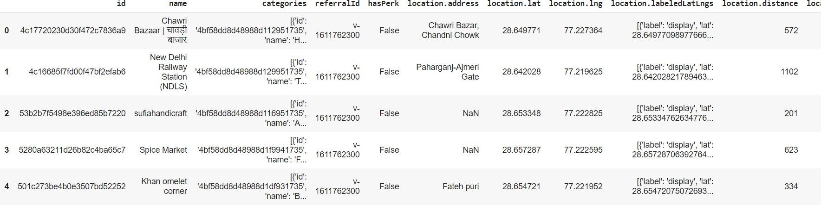
DATA ANALYSIS
Data Collection/Gathering: The data used was the location of schools that was acquired using the foursquare website. To gather the data, foursquare API was used along with the foursquare credentials Client ID and Client Secret. A
‘search’ query was made in the IBM Watson Studio with Python kernel, so as to search the schools. Through the website, coordinates of schools in a particular
location were generated and processed.
Data Preprocessing and Wrangling: Using the modules of python, only valid and usable data was selected from the JSON file generated by foursquare and data-frame was created using ‘Pandas’. Since the project required only the locations, the ‘venues’ section under the ‘response’ section was selected.
The generated data-frame still had numerous of unwanted data inside the
‘venues’ section, which needed to be filtered and cleaned.

Slide 6
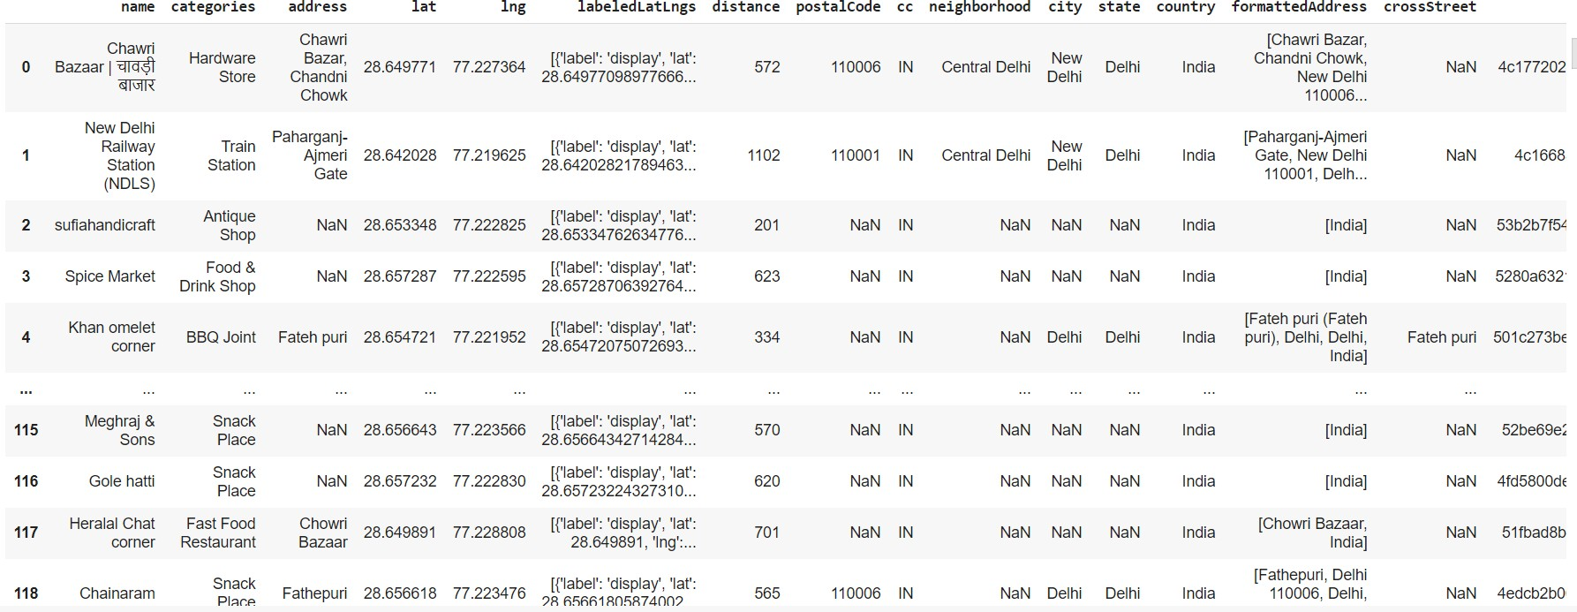
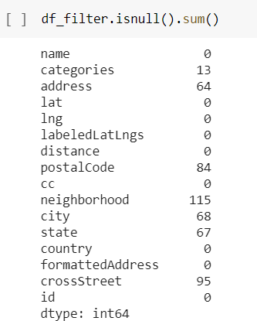
Data Filtering: There are many irrelevant columns in the dataset. So remove the irrelevant columns as it will be of no use. This is known as filtering of data. So we removed columns like categories, hasPerk, id, location.cc, referral id, etc
Checking for null values.

Slide 7
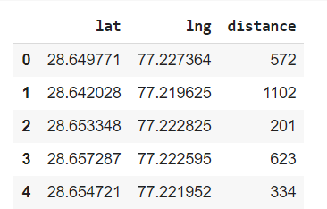
Data Cleaning: To fit the model, one needs to get rid of the null values. Hence, the firstly, the columns with null, none or NaN values, were identified. The cleaning of data was done by removing the columns with NaN or null values.
The columns were dropped keeping in mind whether they were really useful for analysis purpose or not. Heat map is generated for visualizing all the null values of the columns.

Slide 8
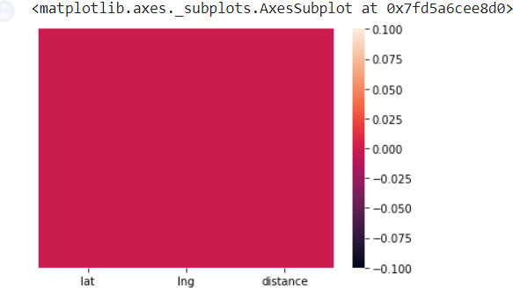
Now fixing null values for City, as we know city is Delhi so we can replace all the null values in City column by Delhi.
Now generate heat map with no null values for verification.

Slide 9
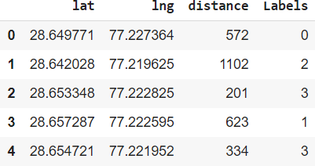
MODEL FITTING
CLUSTERING: Now we will divide places of Delhi on the basis of their location(East
,West ,South and North) by making clusters of different colors.
We will use K-means clustering technique for this project. In this we will specify value of k i.e. number of clusters. K is chosen 4 here. The model was the fitted and the labels were generated in the form of array.
The dataframe is shown below:

Slide 10
Color code: The color codes used in this project are shown below:
Cluster | Color Code
0 | Red
1 | Yellow
2 | Blue
3 | Green

Slide 11
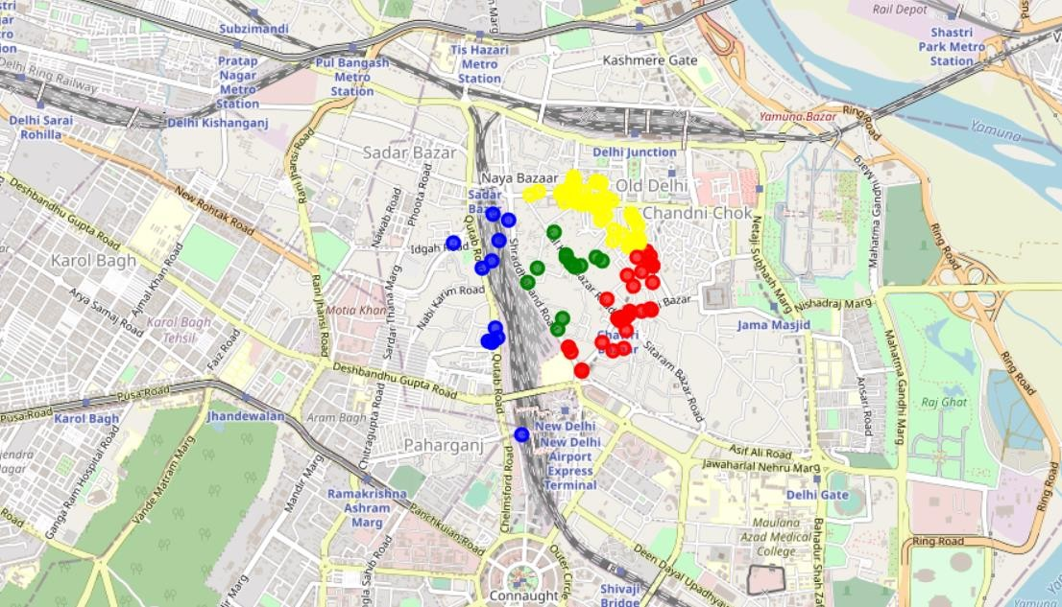
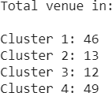
DATA VISUALIZATION
All the 4 clusters were visualized on a map centered on Delhi. The color coding was applied while visualizing for differentiating between the clusters.
Visualizing target cluster: Now we visualize the places on the basis of cluster which is located on the basis of latitude and longitude of each area. There are four colors: Red, Yellow, Blue and Green.
Total Count of places to visit in each cluster:

Slide 12
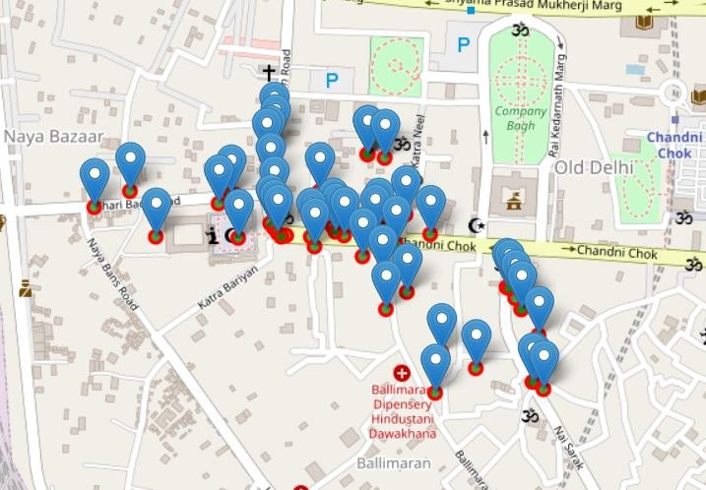
Observation: Hence we can see that Cluster 4 has the maximum places, therefore we will visit places of Cluster 4 to visit maximum places in less amount of time.
Places of Cluster 4 can be visualized using Folium map as shown below:
Project URL: https://drive.google.com/file/d/1z3K7AefLgGQVpBTvXCffv0EmP4MamfYp/vie w?usp=sharing

